Slide 1

Programming using c#

Slide 2

Library Management System

Slide 3
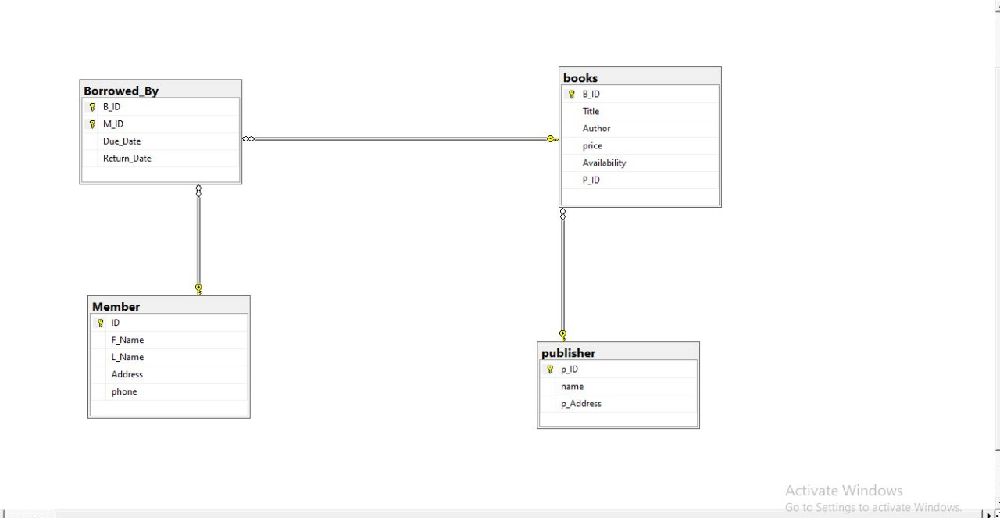
Database Diagram

Slide 4
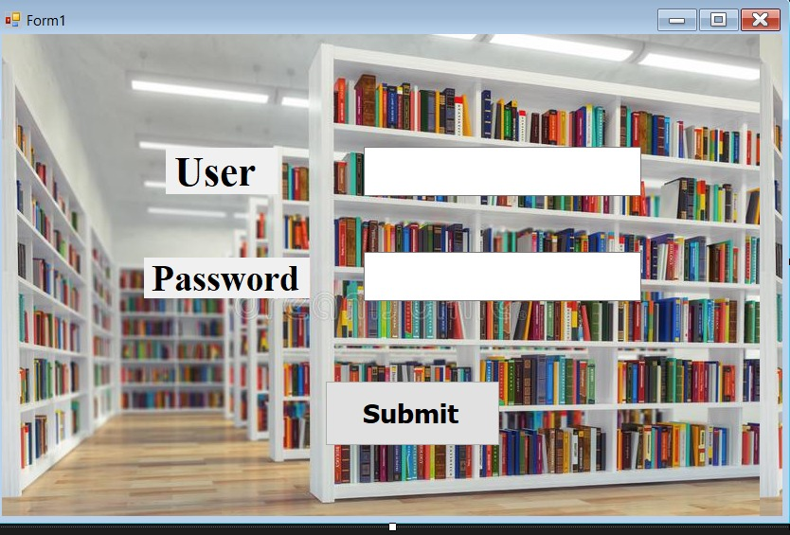
Interface Design

Slide 5
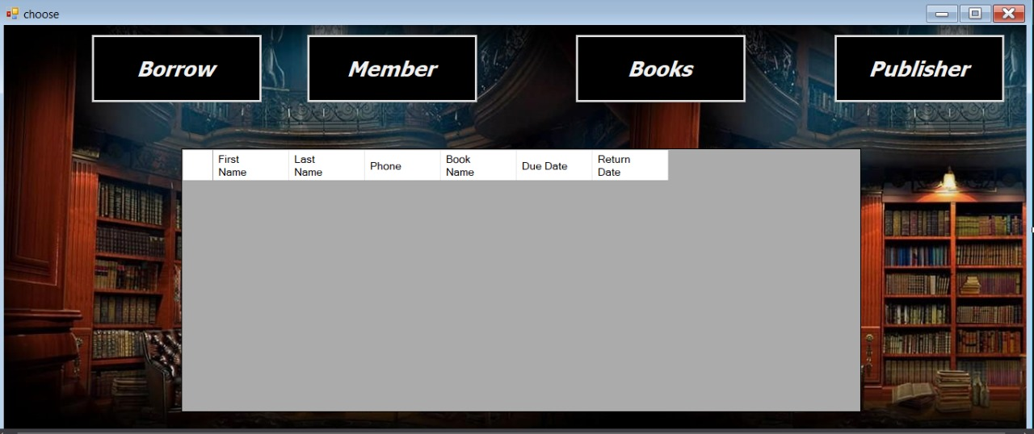
Interface Design

Slide 6
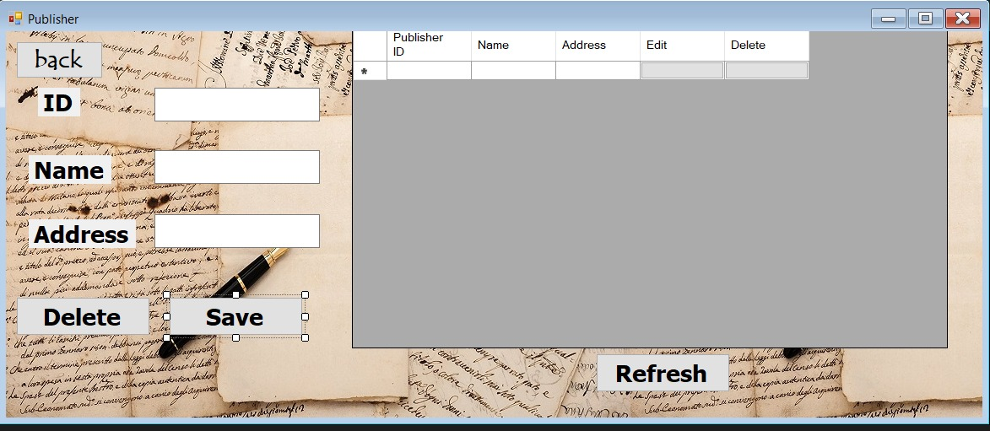
Interface Design

Slide 7
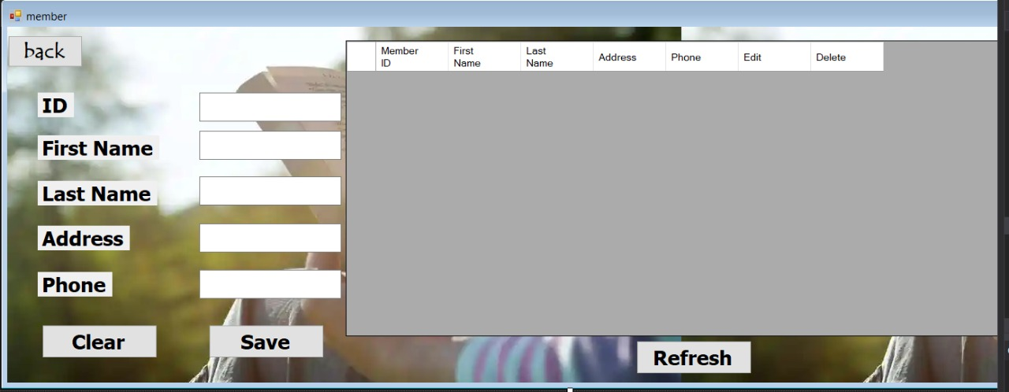
Interface Design

Slide 8
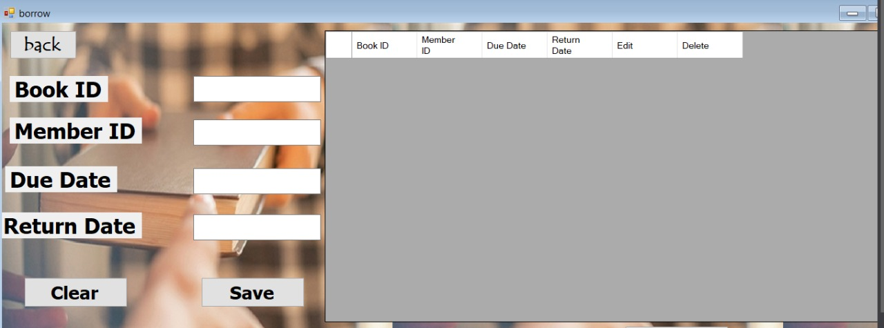
Interface Design

Slide 9
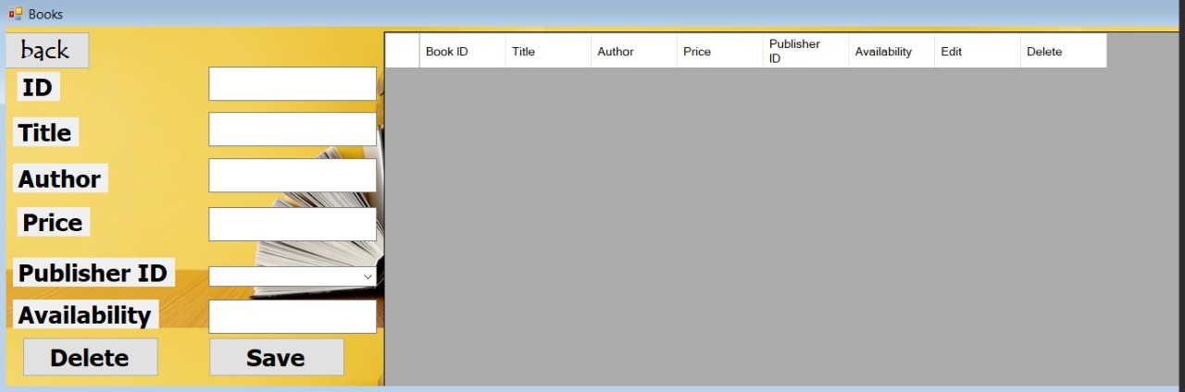
Interface Design

Slide 10
THANKYOU

